Slide 1
Compression

Slide 2
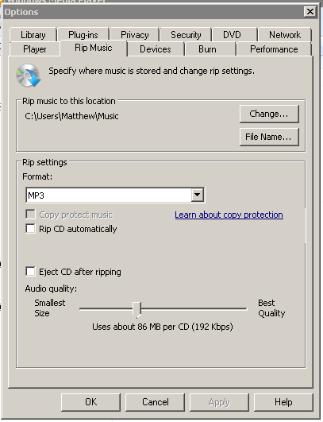
Compression
Ripping a CD…

Slide 3
Why do we care?
Limited storage space
Limited bandwidth
Limited funds

Slide 4
Is it Faster?
Compression – compression takes time
Small file size faster to transfer

Slide 5
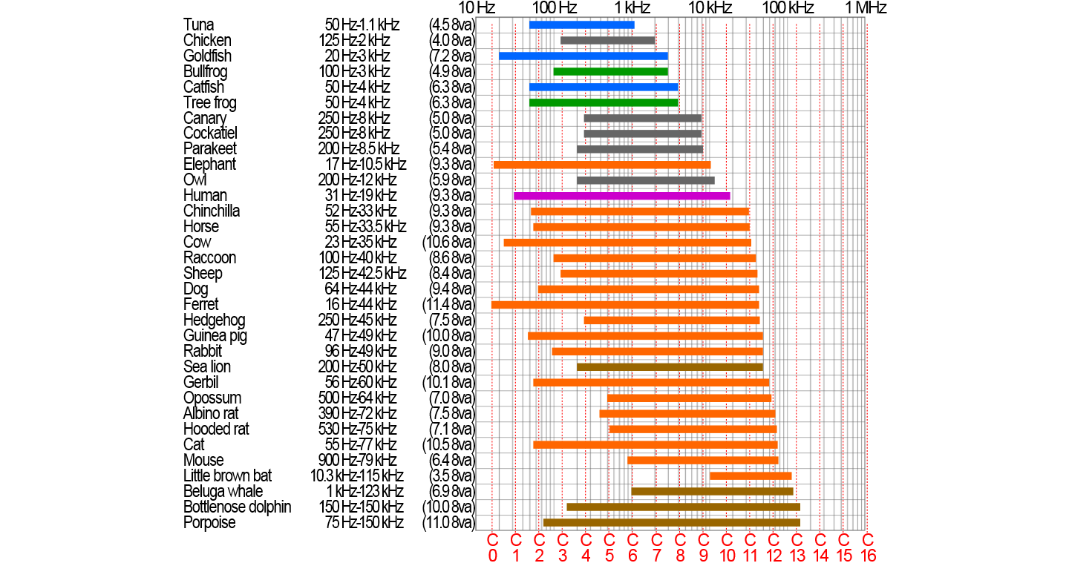
What about quality?

Slide 6
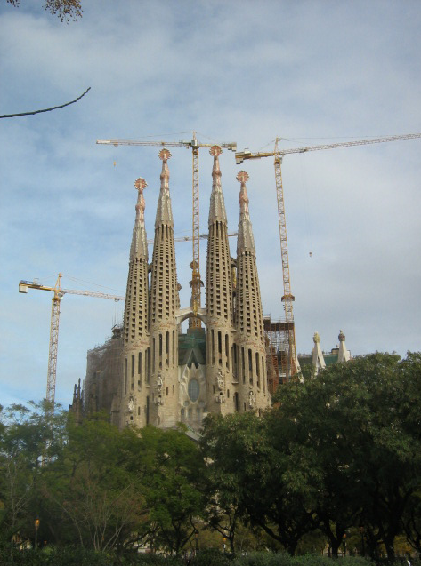
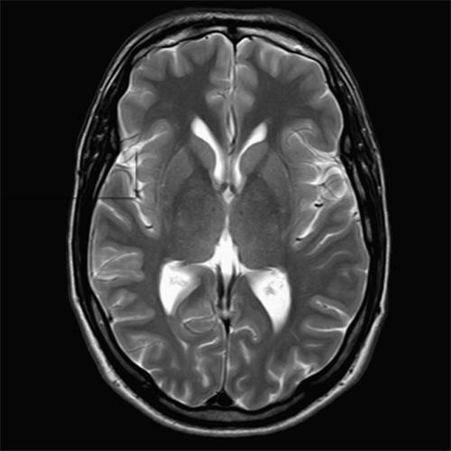
What about precision?
Lossy v Lossless compression

Slide 7
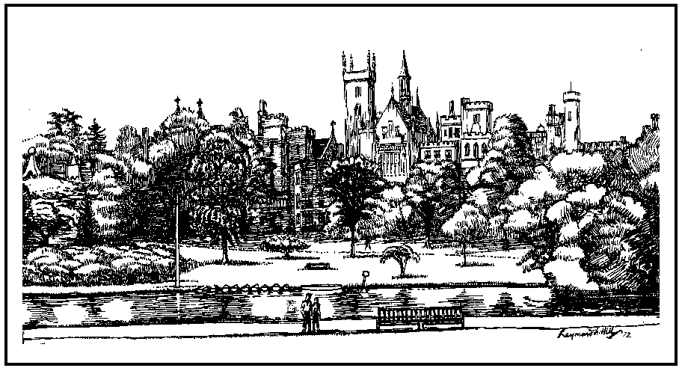
Compression in BMP Files (RLE)
Counts the number of times a byte occurs in a run
Becomes…
Pixel |  |  | Pixel |  |  | Pixel
255 | 255 | 255 | 255 | 255 | 255 | 255 | 255 | 255
9 | 255

Slide 8
GIFF - Lempel Ziv Welch (LZW)
It was the best of times, it was the worst of times, it was the age of wisdom, it was the age of foolishness, it was the epoch of belief, it was the epoch of incredulity, it was the season of Light, it was the season of Darkness, it was the spring of hope, it was the winter of despair, we had everything before us, we had nothing before us, we were all going direct to Heaven, we were all going direct the other way--in short, the period was so far like the present period, that some of its noisiest authorities insisted on its being received, for good or for evil, in the superlative degree of comparison only.

Slide 9
JPEG Compression - lossy
The system stores a complete black and white version of the image and most of its colour information
Human eye can’t tell

